Slide 2
Machine Learning
What, Why, Where and How of ML
“Learning by machine is ML….!”

Slide 3
BTW, Who am I ???

Slide 4
And, What we do Today ???

Slide 5
Dig the concept of ML
ML Pipeline
It’s Types
About Data
Touch code
QUIZ (What winner will get ???)

Slide 6
In 1959, Arthur Samuel defined ML as a "Field of study that gives computers the ability to learn without being explicitly programmed"
https://en.wikipedia.org/wiki/Arthur_Samuel_(computer_scientist)

Slide 7
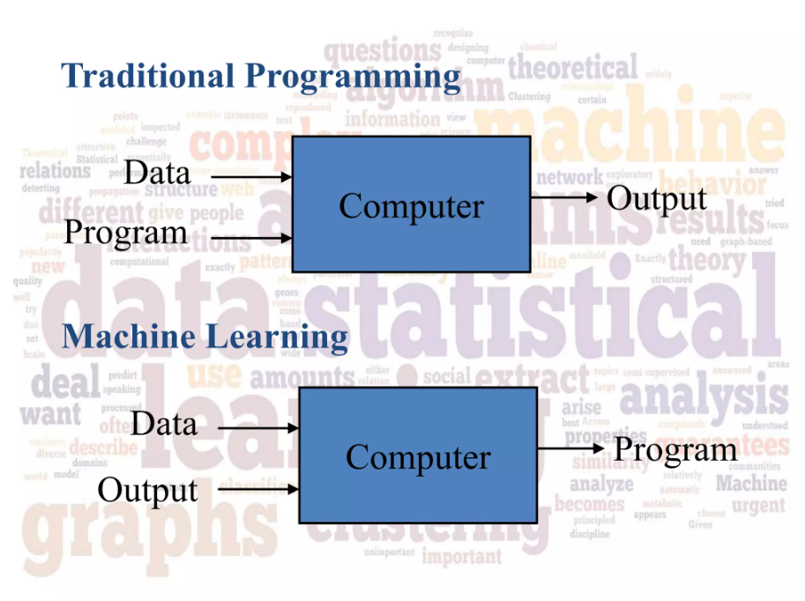
https://www.slideshare.net/darshanharry/machine-learning-46440299#6

Slide 8
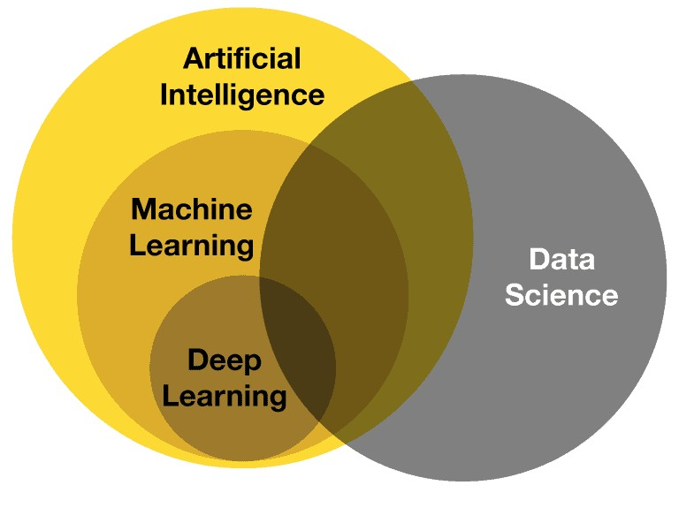

Slide 9
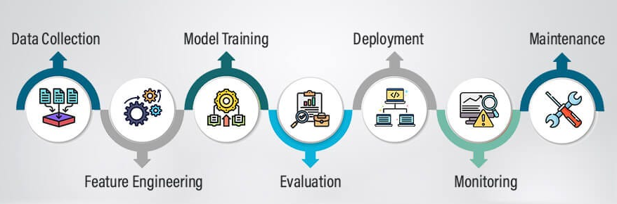
Machine Learning Pipeline
Will explore most of this part in code demonstration… No worries !!!

Slide 10
Data Collection Technique
Manual Data Collection (Surveys, Observation, Data Entry)
Automated Data Collection (Web Scraping, IoT Devices)
Public Datasets (Kaggle, Repository)
APIs
Crowdsourcing
(Will see how’s web scraping is done, hai ta)
Notes:
Crowdsourcing means asking a large group of people (the "crowd") to help with a task or solve a problem.

Slide 11
Feature Engineering
Feature Transformation
Missing Value (Imputation)
Categorical Features (Label, One Hot)
Outlier Detection
Feature Scaling (Normalization, Standardization)
Feature Selections
Remove white px from MNIST dataset
Feature Extractions
Room | Ground | Price
Sq. Feet | Price
(Will see each step in Day-2)
Notes:
Standardization:- mean of 0 and SD of 1 (ensures all features contribute equally to the model)

Slide 12
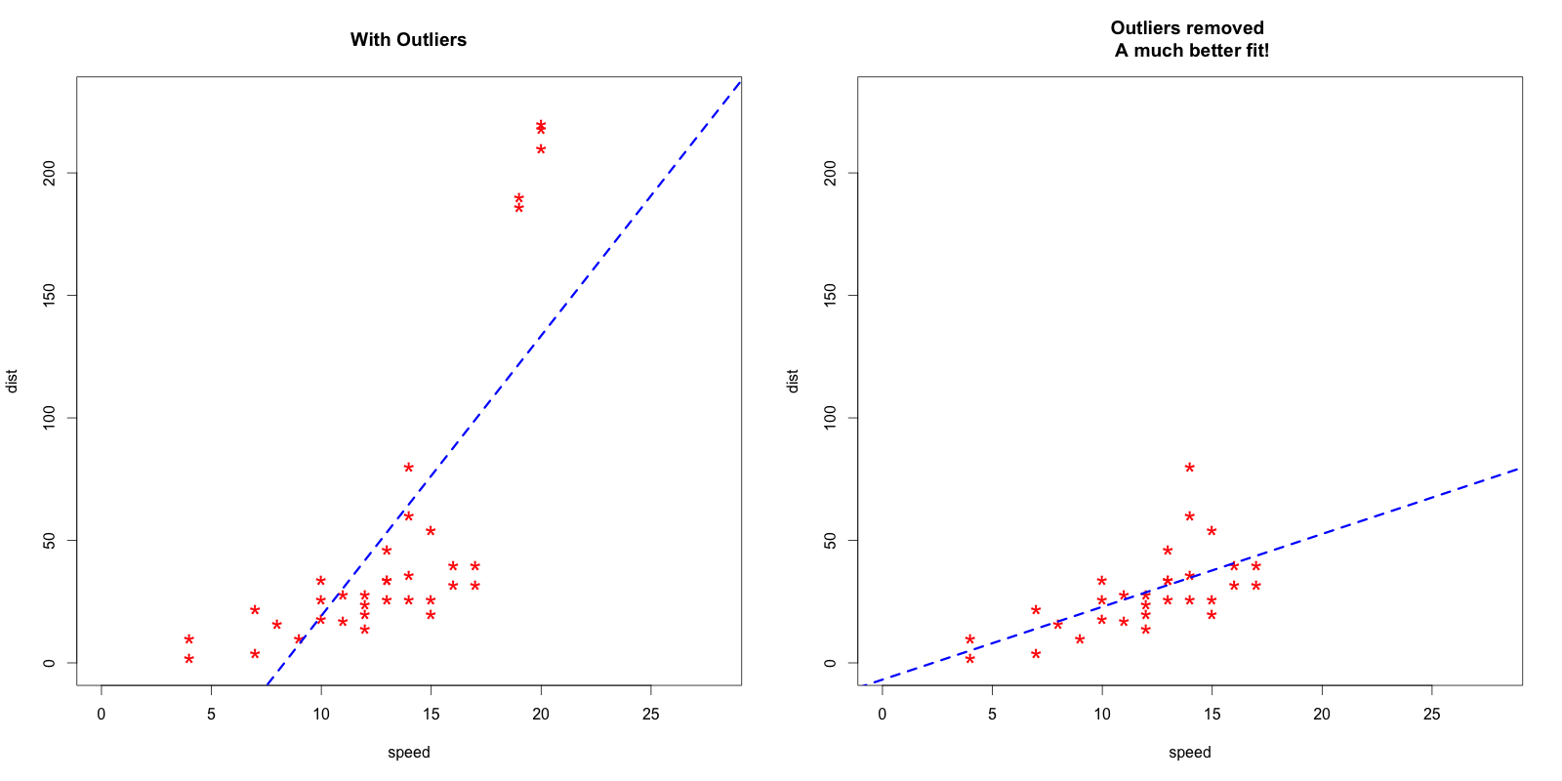
https://datascienceplus.com/outlier-detection-and-treatment-with-r/

Slide 13
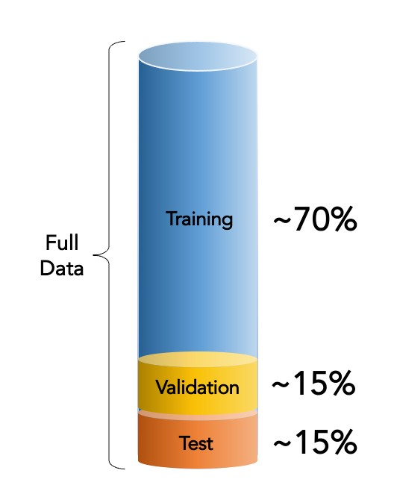
Model Training
Train-Test Split
K-Fold Cross-Validation
Stratified K-Fold Cross-Validation
Bootstrap Sampling
‘ML performance highly depends on the data it is trained with’
Notes:
Bootstrap:- repeatedly drawing samples from the dataset with replacement where some data points may appear multiple times in a subset, while others may not appear at all

Slide 14
Model Evaluation
Performance Metrics
Accuracy
Precision, Recall, F1-Score
Mean Squared Error
Confusion Matrix
Baseline Comparison
Bias-Variance Tradeoff
Underfitting or Overfitting
Notes:
Precision measures how many of the predicted positive cases are actually positive.
Recall measures how many of the actual positive cases are correctly identified.

Slide 15
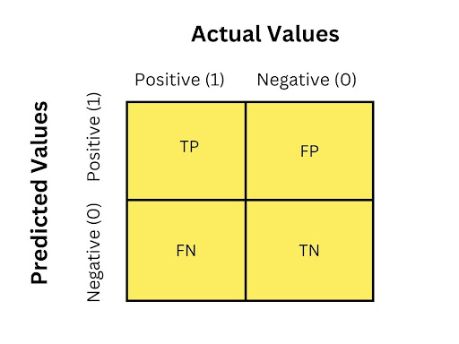
Confusion Matrix

Slide 16
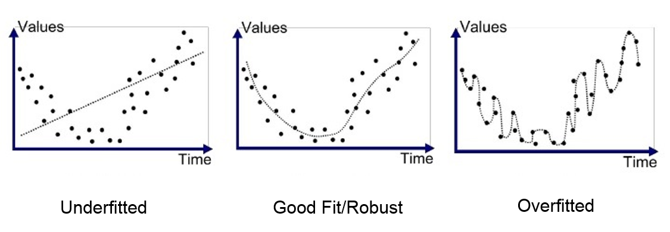
Model’s Generalization

Slide 17
Model Deployment
Hugging Face
Streamlit

Slide 18
Model Monitoring
Data Drift
Changes in input data distribution (Example ?)
Concept Drift
Shifts in target variable relationships (Example ?)
Early Stopping
Prevents overfitting during training
https://www.dataversity.net/data-drift-vs-concept-drift-what-is-the-difference/

Slide 19
Types of Machine Learning
Supervised ML
: Teacher teaches you with examples (Example …?)
Unsupervised ML
: solving a puzzle on your own, with no help from a teacher (Example …?)
Reinforcement ML
: learning by rewards or penalties (Example …?)

Slide 20

Why Data? Why? But Why?
Because the more examples (data) the computer has, the better it becomes at learning.
Notes:
If someone shows you pictures of cats and dogs (data), you can learn the difference—like cats have pointy ears and dogs have floppy ones.

Slide 21
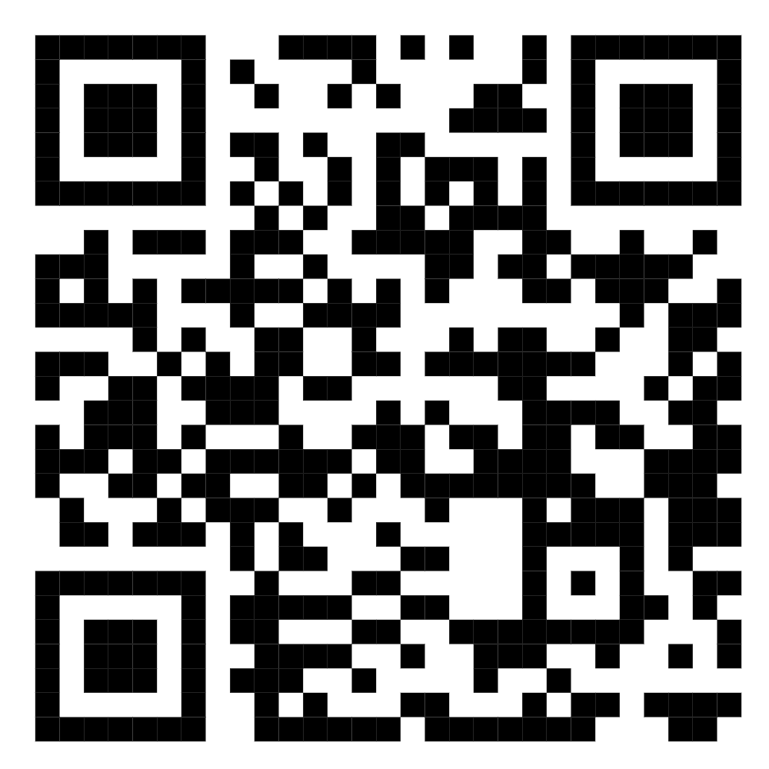
Code Demonstration

Slide 22
Fun Section
READY FOR QUIZ !!!

Slide 23
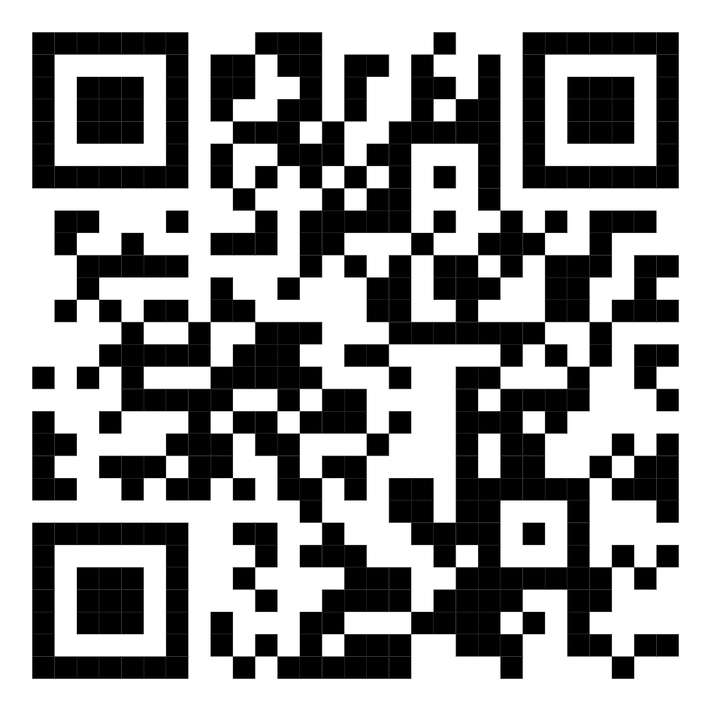
Here, I am
https://khemrajshrestha.bio.link/

